Slide 1

Customer Shopping Behavior Analysis
Uncovering insights from 3,900 purchases to drive strategic business decisions

Slide 2
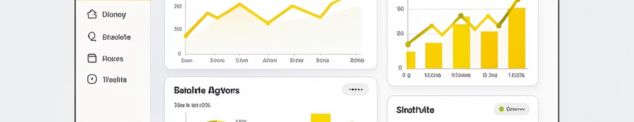
PROJECT SCOPE
Understanding Our Data
3,900
18
37
Total Purchases
Data Points
Missing Values
Transactions analyzed
Features per customer
In review ratings only

Slide 3

DATA FOUNDATION
Key Features Tracked
Customer Profile
Transaction Details
Age, Gender, Location
Product, Category, Amount
Subscription Status
Season, Size, Color
Purchase History
Discounts & Promos

Slide 4


PYTHON ANALYSIS
Data Preparation Pipeline
01
Data Loading & Exploration
Imported dataset, checked structure and summary statistics
02
Missing Data Handling
Imputed review ratings using median by category
03
Feature Engineering
Created age groups and purchase frequency metrics
04
Database Integration
Connected to PostgreSQL for SQL analysis

Slide 5

SQL INSIGHTS
Revenue by Gender
Revenue nearly balanced across genders, indicating broad market appeal
Male
Female

Slide 6

Shipping & Subscription Insights
Express vs Standard
Subscriber Advantage
Express: $60.06 avg
Subscribers: $60.07 avg
Standard: $59.76 avg
Non-subscribers: $59.75 avg
Minimal difference in spend
Higher lifetime value
Repeat Buyers
Customers with 5+ purchases show higher subscription rates

Slide 7
PRODUCT PERFORMANCE
Top-Rated Products
1
2
3
Jewelry
Dress
Blouse
Highest average rating across categories
Strong customer satisfaction scores
Consistent positive reviews
4
5
Sweater
Shirt
Popular seasonal favorite
Reliable everyday choice

Slide 8



Customer Segmentation
Returning
2-5 purchases, building loyalty
New Customers
First-time buyers exploring catalog
Loyal
5+ purchases, highest value segment
Revenue by Age Group
Discount Dependency
Young adults and middle-aged customers drive majority of revenue
5 products show highest discount usage rates

Slide 9

POWER BI
Interactive Dashboard
Visual insights across all key metrics: revenue trends, customer segments, product performance, and behavioral patterns
Notes:
This visual dashboard provides a comprehensive overview of key business metrics and insights At a glance, you can see revenue trends, customer segmentation, product performance, and behavioral patterns The charts and visualizations make it easy to quickly identify areas of strength and opportunities for improvement I'll walk through each section in more detail, highlighting the most important takeaways This dashboard empowers you to make data-driven decisions and drive business growth

Slide 10
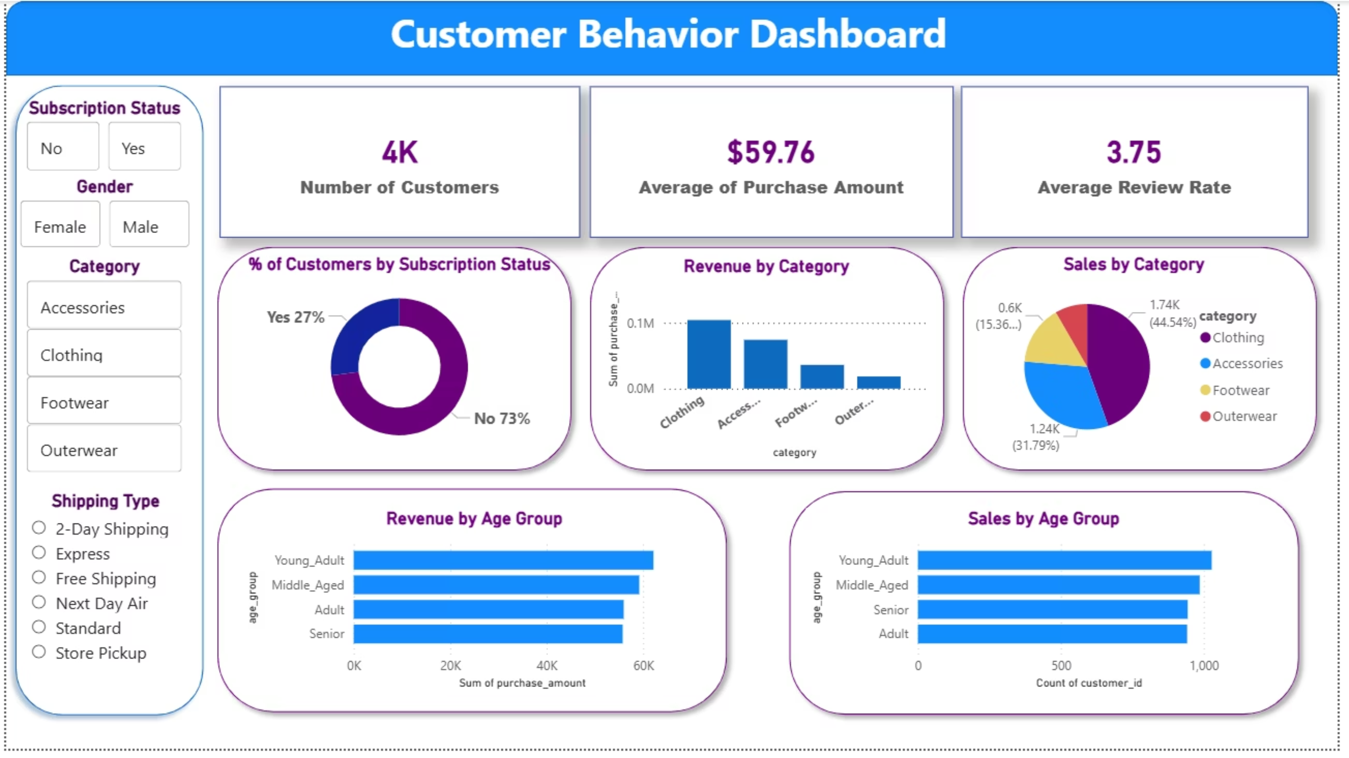

Slide 11





ACTION ITEMS
Strategic Recommendations
Boost Subscriptions
Promote exclusive benefits and rewards
Loyalty Programs
Reward repeat buyers to increase retention
Optimize Discounts
Balance sales growth with margin control
Targeted Marketing
Focus on high-revenue age groups and segments

